Slide 1
Big Mountain Ski Resort
Pricing Model
Honglin Yuan 6/23/2022

Slide 2
Problem Identification
Big Mountain’s current ticket price is $81. It’s above the average in the market segment, but may not be a fair price.
Big Mountain needs a data-driven pricing model before the next ski season so that:
1) its ski facilities are fully capitalized, and
2) the resort can use the model to effectively reduce operating cost and make smart decisions in future investments

Slide 3
Recommendation and Key Findings
Key Findings:
Ticket price is not strongly correlated with the state
Facilities that are most important to price are:
number of fast quads
number of runs
area of snowmaking
vertical drop
Recommendations:
Model suggests a higher price $96.
Recommended changes:
Close down 5 unpopular runs
Add 150m to the vertical drop and a new lift
Start with one change
Validate the model before making more changes

Slide 4
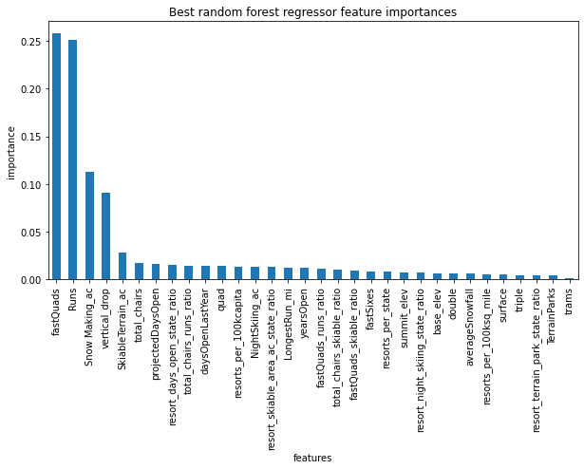
Modeling Results and Analysis - Model Selection
Linear regression model and Random Forest model suggest similar facility names that have a large impact on ticket price.
Random Forest model is chosen as the final model - higher accuracy and less variability.
The estimated prediction accuracy is ~$10

Slide 5
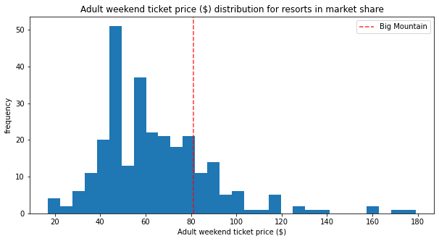
Modeling Results and Analysis - BM Why Higher Price?
A fair price suggested by the model is $96
Although Big Mountain is the most expensive in Montana, it provides the best facilities in the state.
Comparing to the prices of the other resorts across the US, BM prices itself moderately above average.
Adult weekend ticket price

Slide 6
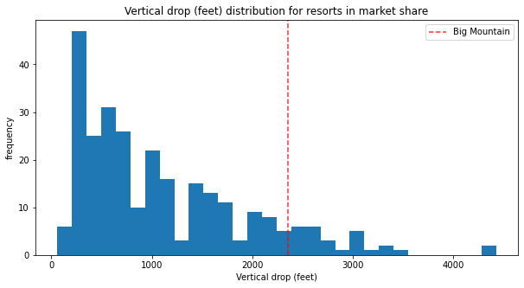
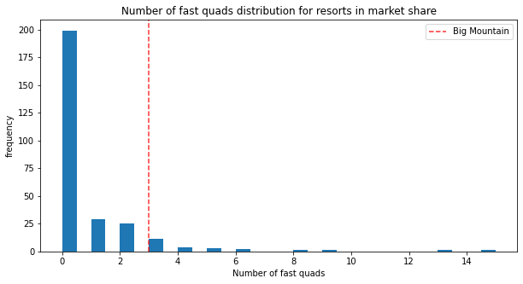
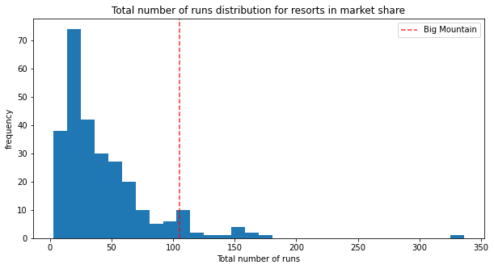
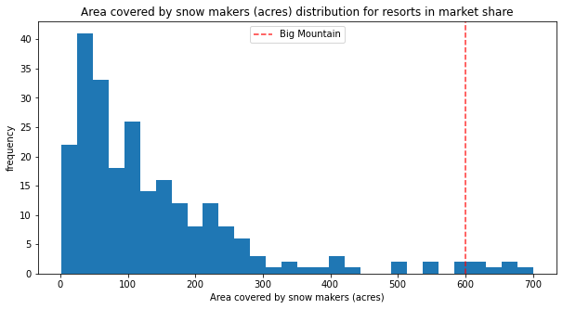
Modeling Results and Analysis - BM Why Higher Price?
However, Big Mountain leads the segment on all primary facilities, which is not fully matched by its current price.
# of fast quads
Vertical drop
Big Mountain
Area covered by snow makers
Total # of runs

Slide 7
Modeling Results and Analysis - Several Scenarios
Scenario 1: closure of 5 runs
Revenue reduction: < $1.2M
Scenario 2: add 1 run, 150m vertical drop, and a new lift
Price increase $2
Revenue increase: < $347K
Scenario 3: scenario 2 + add 2 acres of snowmaking
Same result as scenario 2
Scenario 4: add 0.2 mile to the longest run, add 4 acres of snowmaking
No change to price/revenue

Slide 8
Summary and Conclusions
A Random Forest model is built to predict ski resort ticket price. Accuracy is ~$10.
A fair ticket price for Big Mountain suggested by the model is $96.
The model can be used to estimate potential changes in revenue and operating cost when new investment or cost reduction is considered.
Further work can be carried out to improve the model with additional information such as operating cost and number of visitor etc..

